Slide 1
North Hartford Ascend Pipeline Funded by the U.S. Department of Education
September 20, 2023
L
Notes:
Luz
Good evening and welcome to the North Hartford Ascend Pipeline Community Conversations. My name is Luz Holmes, Ascend Community Partner.

Slide 2
This meeting is being recorded and the recording will be posted on the Connecticut Children’s website.
L
Notes:
We ask that guests remain muted during the presentation. Please submit comments or questions in the chat and we will facilitate a Q&A after the presentation.

Slide 3
Por favor recuerde seleccionar su lenguaje en el globo de la parte inferior de su pantalla para interpretación Desde su celular, toque los 3 puntos y seleccione su lenguaje.
Please remember to select your language on the globe at the bottom of your screen for simultaneous interpretation. From your cell phone, touch the 3 dots and select your language.
L
Notes:
We ask that guests remain muted during the presentation. Please submit comments or questions in the chat and we will facilitate a Q&A after the presentation.

Slide 4
Incentive Available to Hartford Residents
L
Notes:
https://forms.gle/q7KQxRQGHbqcYiJT7

Slide 5
Agenda
Welcome & Guidelines
Ascend Announcements
Ascend Overview
August Meeting: Resource & Data Review
Family Navigators with The Village for Families and Children
Next Steps and Closing Remarks
L

Slide 6
Discussion Guidelines
Everyone deserves to be heard.
Online: Turn your camera on (we would love to see you), and keep your mic muted unless you’re speaking.
Don’t be afraid to use the chat!
Listen and respond respectfully.
Let’s stay on topic– time is limited, so let’s value each other’s time.
Successful dialogue is the responsibility of all participants.
L
Notes:
**Please keep in mind this is a brainstorming session, not everything said will be implemented etc.**

Slide 7
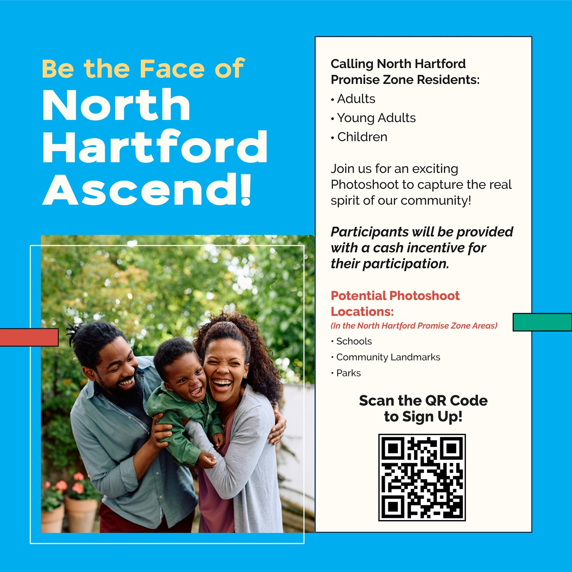
Ascend Announcements: FourteenG

Slide 8
Notes:
https://northendascend.com/community-branding/

Slide 9
North Hartford Ascend Pipeline
C
Notes:
Michelle Transition to Courtenay

Slide 10
Purpose
To collaboratively build an integrated and coordinated pipeline of services and supports that helps children and families reach their full potential.
C

Slide 11
Current State
Strong Array of Programs, Services, Supports of Community-Based Organizations in Promise Zone Neighborhoods
Opinions, Priorities, Concerns, Needs of Promise Zone Neighborhoods’ Residents and Families
C

Slide 12
Ideal State-Ascend System Building
Care Coordinators
WIC Staff
Career Navigators
Family & Community Support Services Providers
Community Health Workers
Home Visitors
211 Child Development
Care Navigators
Funding to Address Gaps & Capacity Issues
Opinions, Priorities, Concerns, Needs of Promise Zone Neighborhoods’ Residents and Families
North
Hartford
Ascend Pipeline
Programs, Services, Supports of Strong Community-Based Organizations in Promise Zone Neighborhoods
COMMUNITY VOICE AND CO-PRODUCTION

Slide 13
U.S. DOE Promise Neighborhood Program Results
Students. . . .
Enter kindergarten ready to succeed in school.
Are proficient in Math and English Language Arts.
Successfully transition from middle to high school.
Graduate from high school.
Obtain post-secondary degrees, certifications, or credentials.
Are supported by families and communities in their learning.
Are healthy.
Feel safe at school and in the community.
Live in stable communities.
Have access to 21st century learning tools.
C

Slide 14
Resource & Data Review
W
Notes:
Michelle Transition to Courtenay

Slide 15
Q&A: August Meeting
Q: Where can families get uniforms for their students if they cannot afford them?
A: Contact your child’s school: Family & Community Service Support Provider (FCSSP), the Welcome Center (860-695-8400), or by written request to the Principal
Q: Do excused absences still count against a student’s overall attendance?
A: Excused absences do not count “against” students – only unexcused absences count towards truancy
A: Chronic absenteeism, which is a measure of exposure to learning and school-based supports, counts all absences, whether excused or not, because any absence results in a missed opportunity to learn and receive support
Used for monitoring and implementation of tiered support, not “held against” students
W

Slide 16
Q&A: August Meeting
Q: How are schools bringing along students and families who started HS during covid and did not get adequate orientation?
A:Families can contact their school’s FCSSP or the Welcome Center (860-695-8400)
Q: Are there alternative learning programs available for students who are chronically absent?
A: Yes, there are alternative paths to credit attainment, including HOPE academies and Our Piece of the Pie
Q: Is chronic absenteeism now chronic and intractable?
A: While a critical and “stubborn” challenge, chronic absenteeism rates declined substantially in 2022-23, demonstrating that solutions are attainable.
Q: Is there data to categorize if students with special needs are more or less chronically absent?
A: Yes, and we will present some data on this in a few minutes!
W

Slide 17
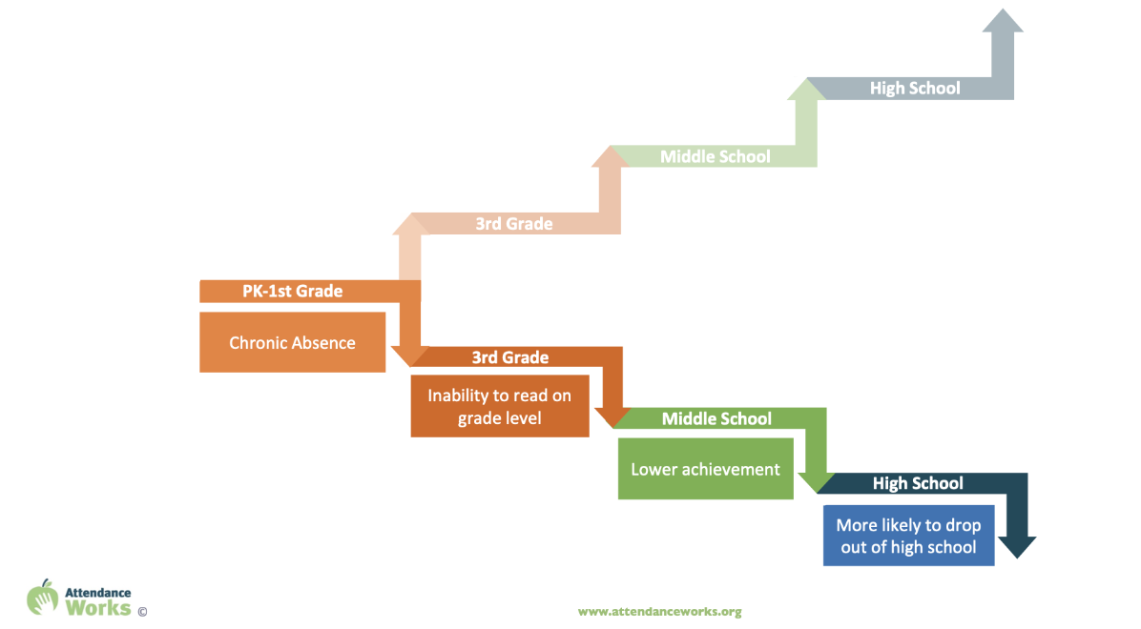
Impact of Chronic Absence
Notes:
Pre-pandemic 8 million students were chronically absent nationally
SY 2021-22 chronic absence doubled to 16 million students
SY 2022-23 chronic absence rates remained high and was higher than ever for early elementary and high school
These numbers make it so urgent bc the research and data tells us just how much attendance matters…16 million kids are not learning on a regular basis…which has lifelong implications….
Focus early grades
Chronic absence highly correlates with students falling off the path toward academic success.
Negative
Chronic absence in kindergarten and 1st grade can lead to the inability to read on grade level by the end of 3rd grade.
The inability to read on grade level by 3rd grade leads to lower academic achievement in middle school.
Students that do not read on grade level are 4 times more likely to drop out of high school.
Positive
Students who attend regularly in the early grades perform better on measures of academic and social and emotional capacities.
Students who attend school regularly are more likely to be able to read proficiently by the end of 3rd grade.
Students who attend school regularly are more likely to have passing grades in middle school.
Students who attend regularly are more likely to graduate from high school.
Students who attend school regularly in high school are more likely to persist in college and graduate.
Point
While showing up does not guarantee learning, a student who misses class cannot benefit. If a large number of students miss class, it is an indication of challenges that require systemic solutions.

Slide 18
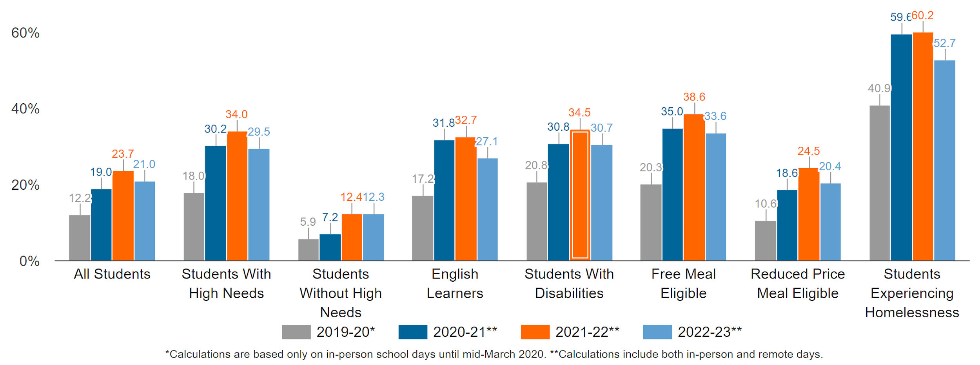
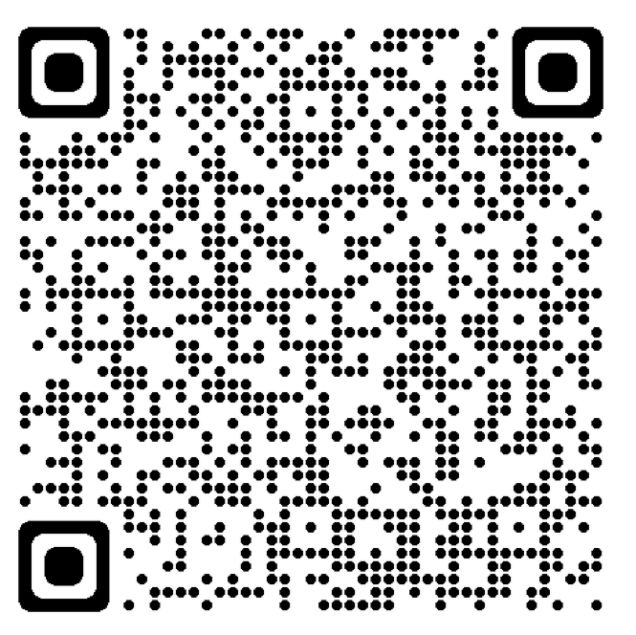
State Chronic Absence Trends
Source: CT EdSight, Monthly Attendance Reports, Supporting Student Participation (ct.gov)

Slide 19
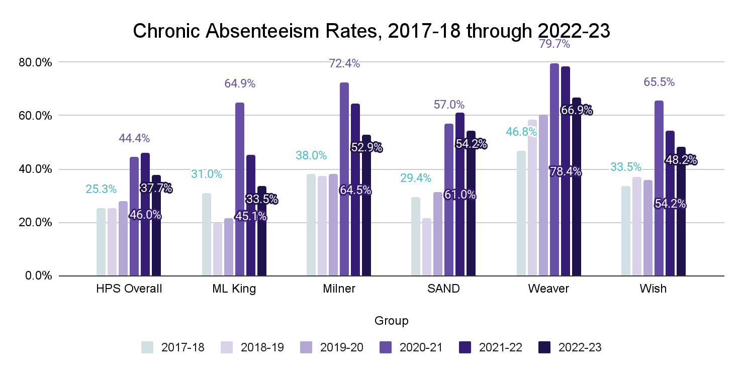
Chronic Absenteeism Trends: Promise Neighborhood Schools

Slide 20
Key Takeaways
Chronic absenteeism rates across CT doubled during the Pandemic
Chronic absenteeism improved in 2022-23
Statewide: 18,442 fewer students were chronically absent (-3.7 points)
HPS District: 1,251 fewer students were chronically absent (-7.1 points)
Promise Neighborhood: 166 fewer students were chronically absent (-7.8 points)
MLK made the most improvement (27.7% decline in CA rate)!
Chronic Absenteeism rates are related to % of students with “high needs” (English Learners, Free/Reduced Lunch, Disability)
Notes:
6.8% of the decline in the number of chronically absent students across the state were due to reductions in HPS students (but HPS only accounts for 3.1% of state enrollments)
MLK = 12.5 point reduction
Percent change in CA Rates:
CT = -15.6%
HPS = -15.4%
PN = -12.2%
MLK = -27.7%
Milner -16.6%
Weaver = -10.3%
Wish = -10.3%
SAND = -9.2%

Slide 21
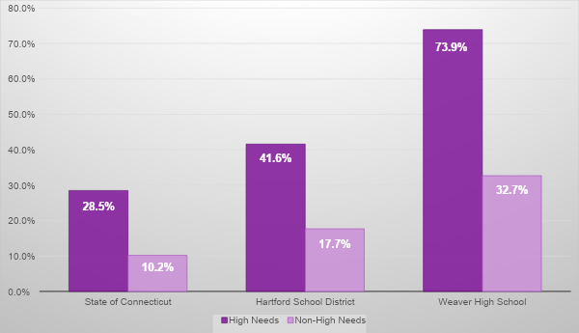
Chronic Absenteeism by Student Needs (2022-23)

Slide 22
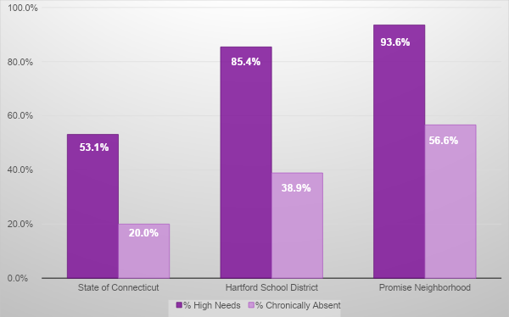
Percent High Needs and Chronically Absent (2022-23)
Notes:
These relationships hold over time (2018 until 2023)

Slide 23
Questions about data on chronic absenteeism?

Slide 24
Ascend Program
The Village for Families and Children, Inc.
2023
Village Ascend Team
Norma Pizarro- Team Leader
Thais Ortolaza- Community Family & Services Manager

Slide 25
Ascend Goal
The North Hartford Ascend Pipeline is a cradle-to-career effort to ensure children living in the North Hartford Promise Zone – which includes the Clay Arsenal, Northeast, and Upper Albany neighborhoods – have the supports they need to reach their optimal potential.
Notes:
Target: Families that live in the Northend of Hartford who are prenatal and/or have children under the age of 18.

Slide 26
Ascend Family Navigators
Are embedded in the community to serve North Hartford families from prenatal to career pipeline to ensure overall student academic success and school attendance
Engage, outreach, and recruit families
Screen, refer and connect families to services within their neighborhoods
Notes:
Identify-Navigate-Connect

Slide 27
Ascend connects families to…
Basic Needs
Physical and mental health Services
Financial Empowerment Services
Early Childhood Programs
Other services to remove barriers

Slide 28
Identify client
Screen
Identify Resources
Connect to resources
Reevaluate needs- discharge if needed, or continue to connect to resources

Slide 29
Referrals
How can you refer families?
Email ascend@thevillage.org
Add the parent’s or guardian’s name, phone number, and needs in the body of the email.
Interested in other Village programs?
Visit the Village Website at www.thevillage.org or dial 860.236.4511

Slide 30
Questions?

Slide 31
Discussion Questions
Did The Village provide a clear overview of The Village Ascend Navigators?
Do you know how to access Family Navigation services? What would be helpful to you in accessing services?
What would you like to know that wasn’t shared today?
L
Notes:
20 mins

Slide 32
Thank You!
Upcoming meeting: Wednesday, October 18th at 6pm
Are you interested in facilitating or taking notes during future Community Conversation breakout groups? Contact Ally McGinty at amcginty@unitedwayinc.org to sign up for the Facilitating and Note-taking Workshop.
An incentive is available to Hartford community members participating in this meeting. The link is posted in the chat and will be sent out via email. Contact Ally McGinty at amcginty@unitedwayinc.org with any questions.
Please take the Post Meeting Survey to share your thoughts and feedback. The link is posted in the chat and will be sent out via email.
Any feedback and or questions, contact nhap@connecticutchildrens.org
L

Slide 33
Program Name
People served & Outcomes
How many people does the program serve overall and in the Promise Zone neighborhoods (if data is available)
What have past recipients experienced
Eligibility
Notes:
Percent of Promise Zone (PZ) reached?

Slide 34
Program Name
How to get connected
If more info is available, add websites, QR codes, etc to this slide
What to expect after initial encounter
How to reach program

Slide 35
Employment Opportunities
Program Coordinator, North Hartford Ascend Pipeline
https://recruiting.adp.com/srccar/public/RTI.home?d=External&c=1122041#/
Career Navigator Systems Coordinator, Capital Workforce Partners
https://capital-workforce-partners-cwp.careerplug.com/jobs/2038810/apps/new
M
Notes:
Michelle. The links will be entered into the chat.

